Slide 1

Android Architecture
2024
By Bikal Thapa

Slide 2
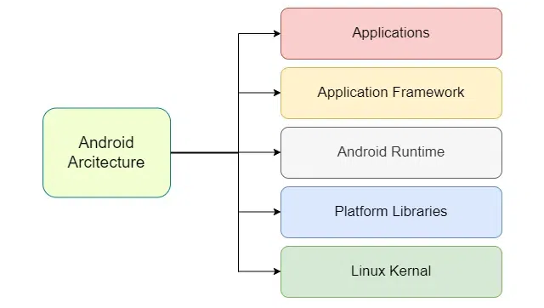
Android Architecture
2024
Android architecture is a layered system that provides a robust and flexible platform for mobile development.
Describes the working mechanism of Android OS.
Introduction

Slide 3



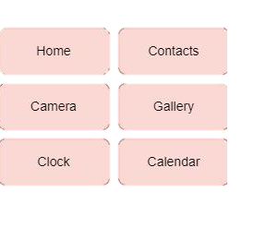


Application Layer
2024
Topmost Layer
Third party apps
It is the topmost layer of android architecture.
Pre-Installed and third party apps are present in this layer.
Customizable
User Interaction
Developers can create custom application to extend functionality.
It is the layer in which user interacts with.

Slide 4


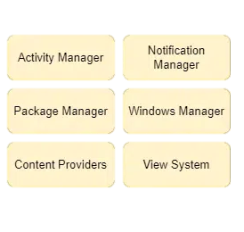


Application Framework
2024
Second Layer
Foundation for apps
It is the second layer of android architecture.
Provides the essential building block for creating android application.
Resource Management
Communication
It handels resources like layout, string and graphics.
It allows multiple apps to communicate with each other.

Slide 5




Libraries
2024
Third Layer
Core Library
It is the second layer of android architecture.
Provides the essential functionality for development including data structures.
Media Libraries
Security Library
Provides platform for audio visual and graphics.
SSL ensures secure connection and data protection.

Slide 6
Android Runtime
2024
Third Layer
ART (Android Runtime)
It is the second layer of android architecture.
Use ART to compile bytecode into native code in newer version of android.
Linux Kernel Dependent
DVM
ART is dependent on Linux Kernel for memory and process management.
Used in the older Version (below 5.0) for converting bytecode into machine code.

Slide 7

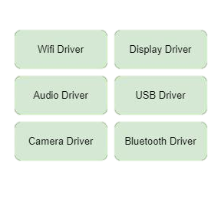


Linux Kernel
2024
Last Layer
Hardware Communication
It is the last layer of android architecture.
This layer is responsible for communicating with hardware.
Handles Device Drivers.
Network Communication
This layer handles the device drivers like camera, keypad, memory, etc.
This layer helps to be connected over internet using wifi driver.

Slide 8

THANK YOU!

